Slide 1
Say.wrıte.show-developıng pupıls’ and teachers’ communatıon skılls
BORNOVA KARACAOĞLAN MAHALLESİ SECONDARY SCHOOL
05-11/11/2017 BUCHAREST
BLENDED MOBILITY FOR LEARNERS
SHORT TERM JOINT STAFF

Slide 2
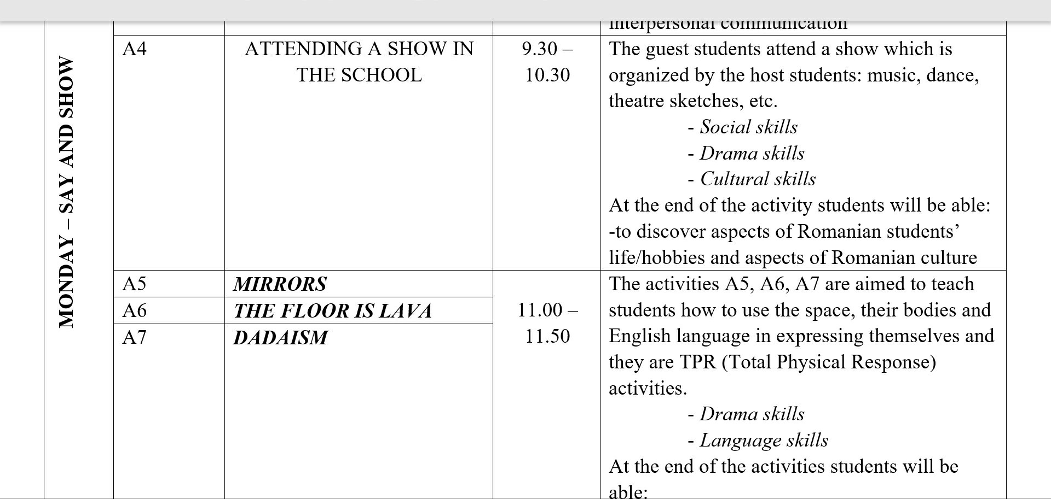
STUDENTS’ PROGRAMME

Slide 3
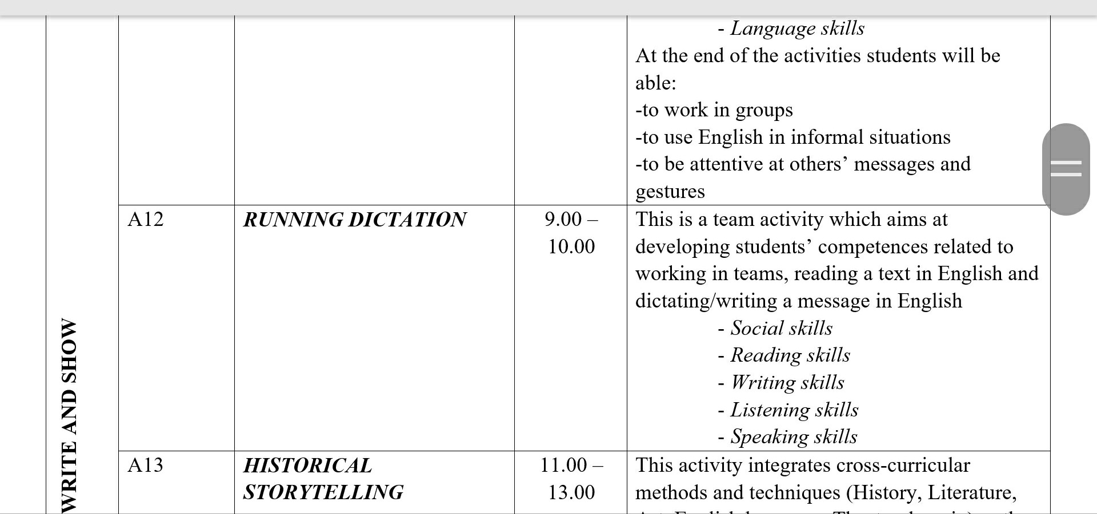
STUDENTS’ PROGRAMME

Slide 4
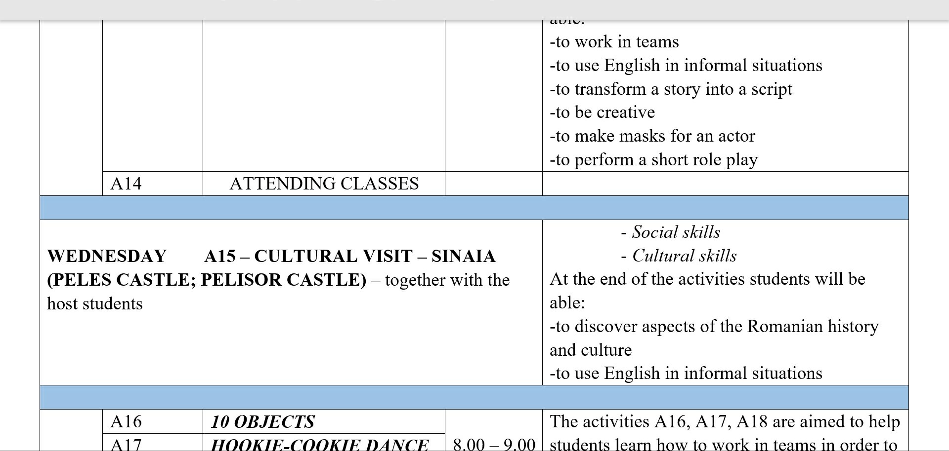
STUDENTS’ PROGRAMME

Slide 5
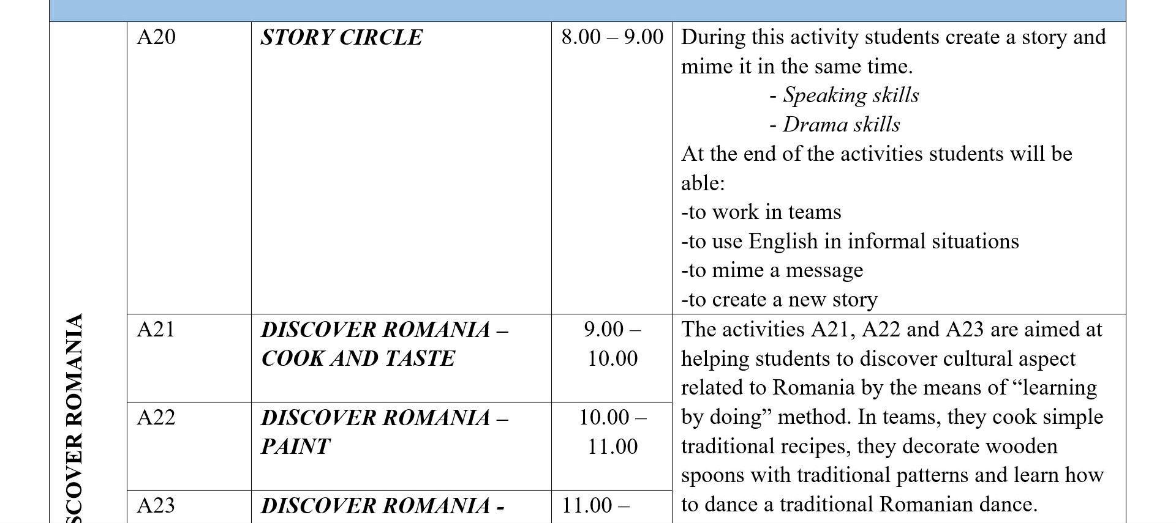
STUDENTS’ PROGRAMME

Slide 7
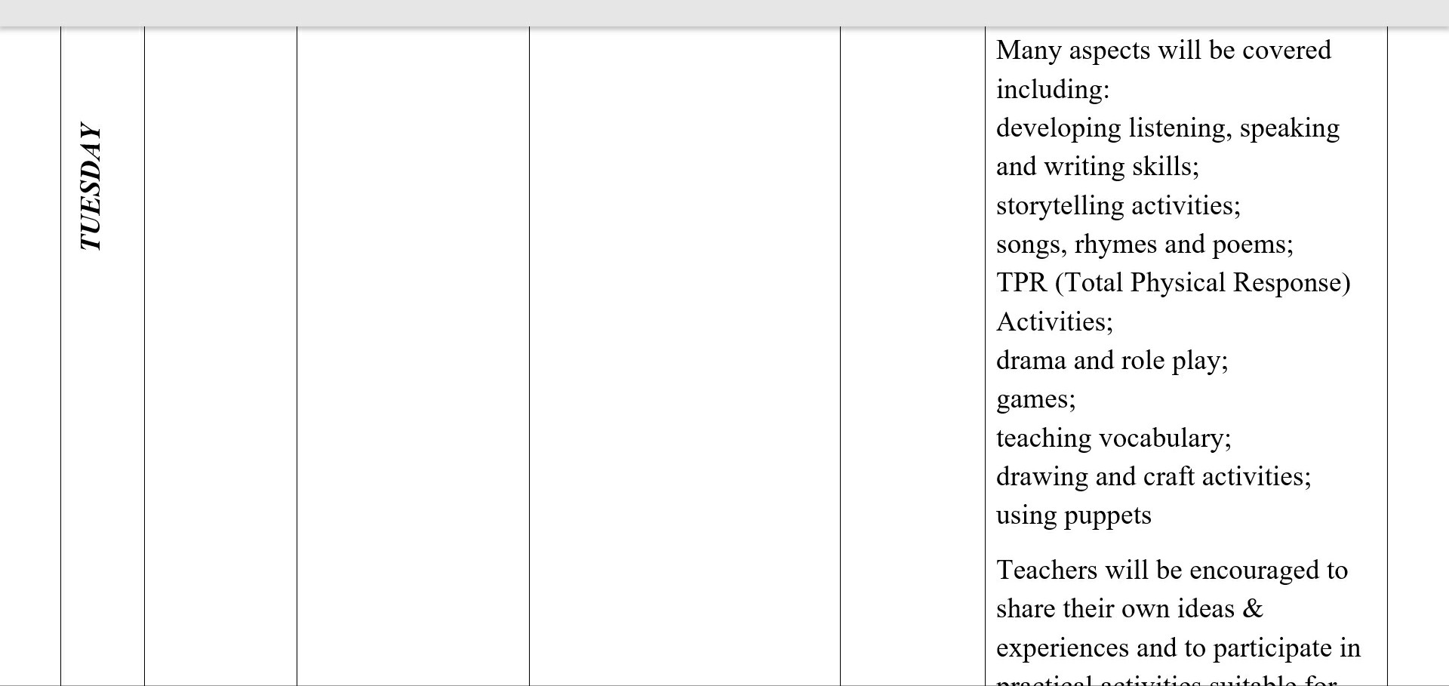
TEACHERS’ programme

Slide 8
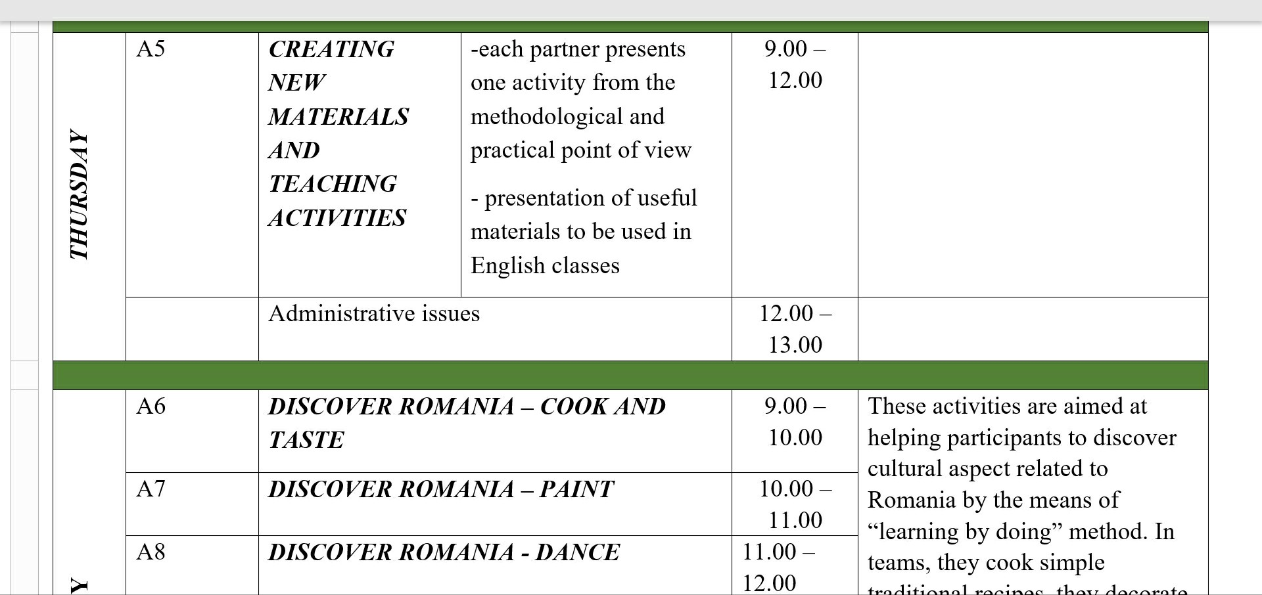
TEACHERS’ programme

Slide 9
TEACHERS’ programme

Slide 10
SCHOOL PARTICIPANTS
STUDENTS:
Yaren Öztürk
Burak Ergül
Hüsne Hazal Altıkulaç
TEACHERS:
Füsun Güzelordu
Ayşe Dilek İzgin

Slide 15
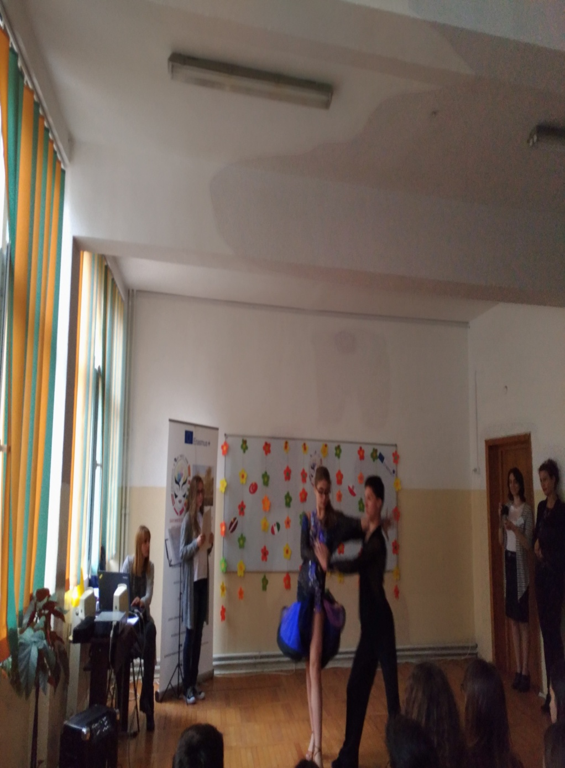

Slide 19
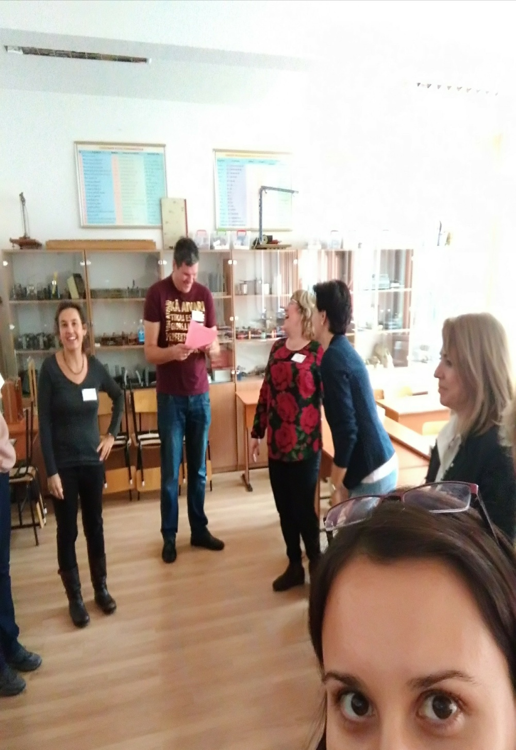

Slide 28
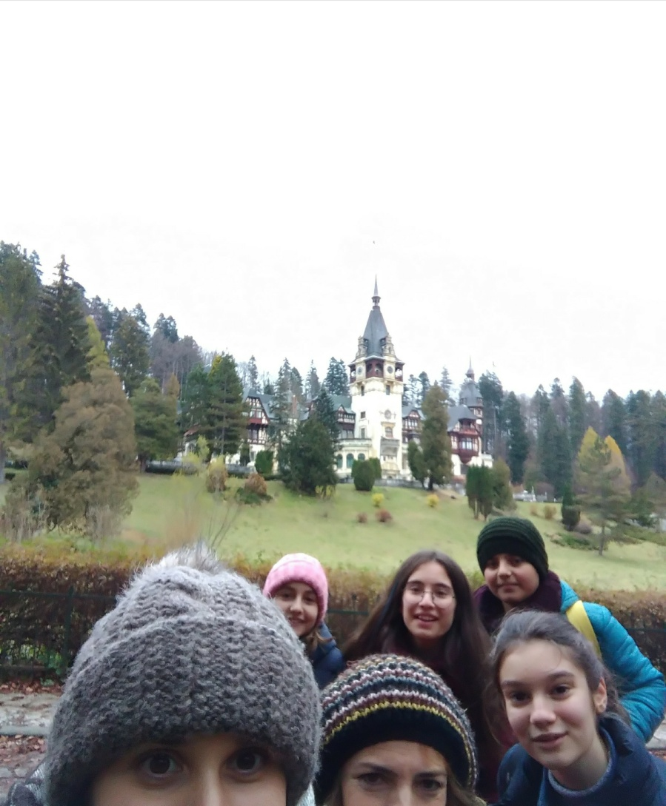

Slide 30
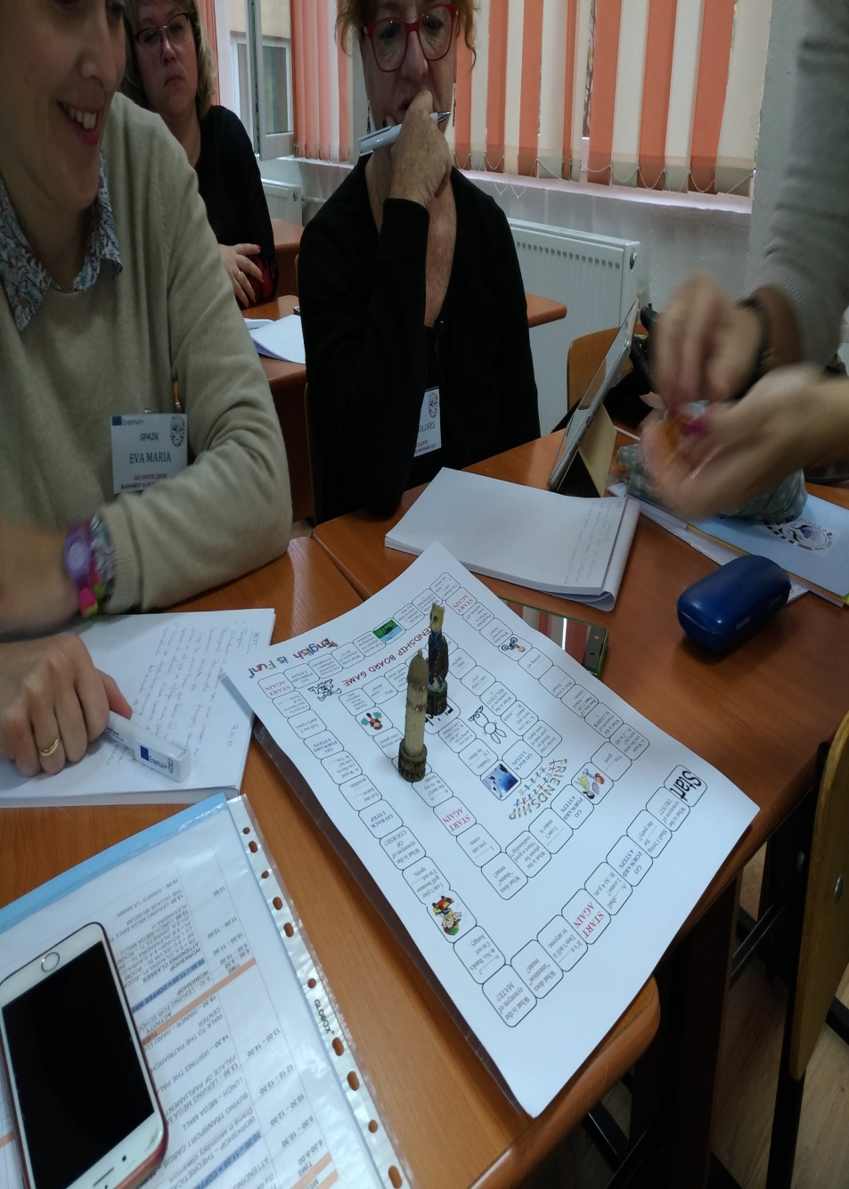

Slide 31
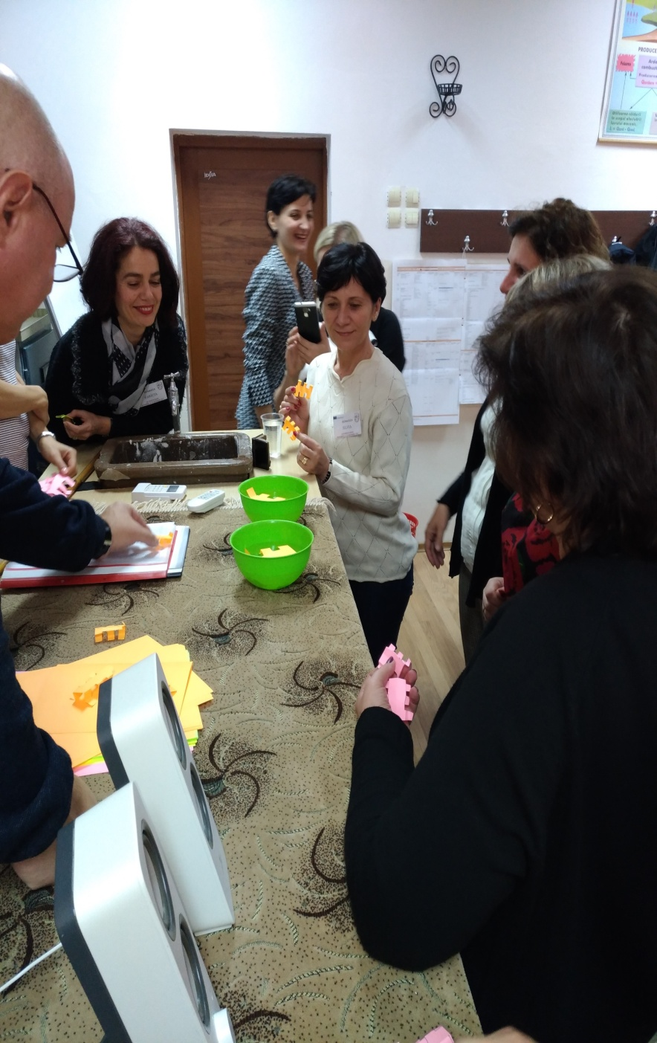

Slide 37
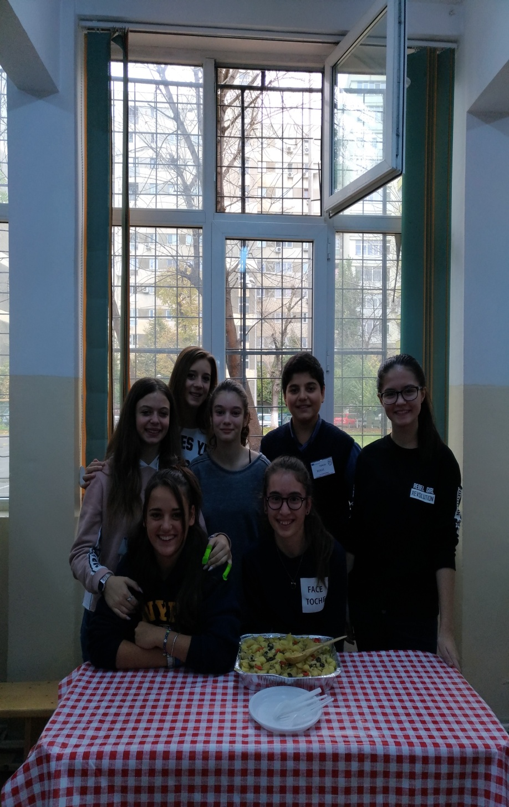

Slide 38
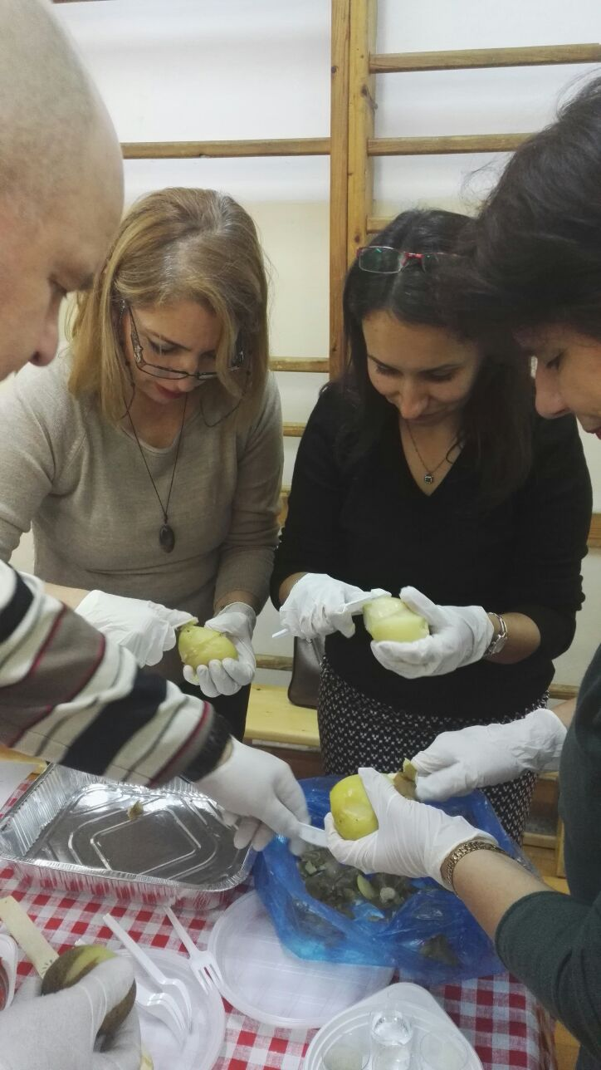

Slide 42
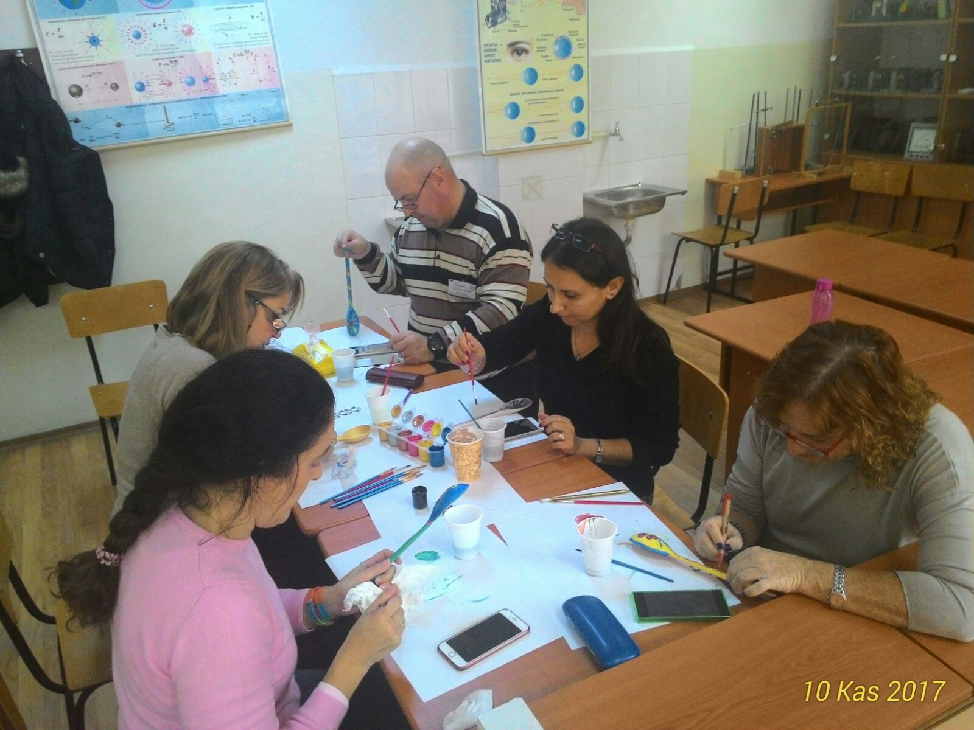

Slide 44
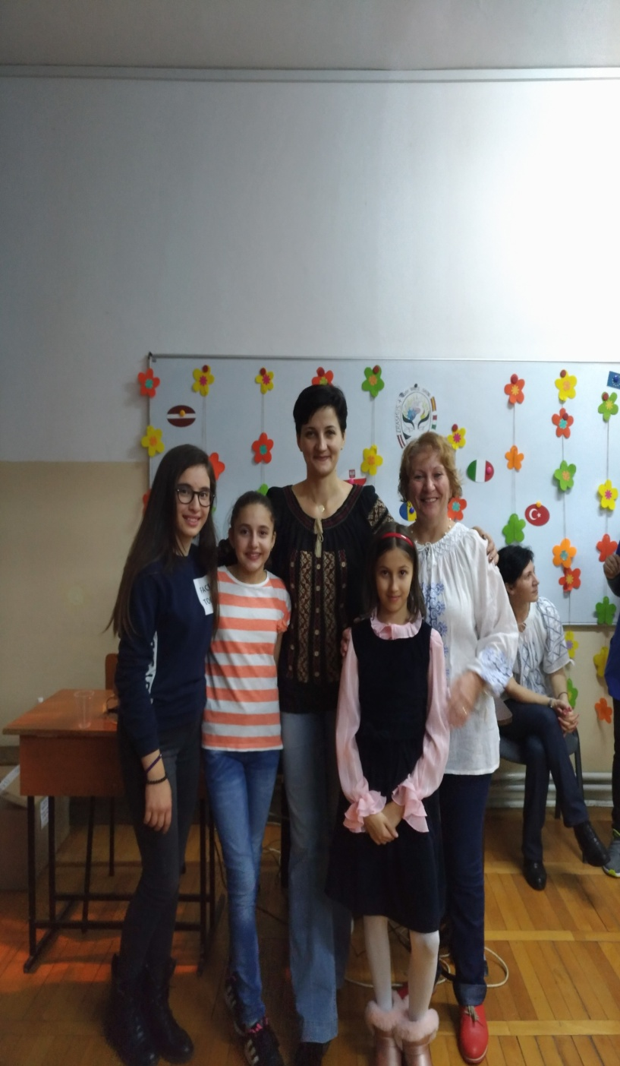

Slide 47
THANK YOU ROMANIA!
THANK YOU BUCHAREST!
THANK YOU SCHOOL NO 51!

