Slide 1





SAY.WRITE.SHOW – DEVELOPING STUDENTS’ AND TEACHERS’ COMMUNICATION SKILLS
TRANSNATIONAL MEETING
ROMANIA-BUCHAREST
15-18 DECEMBER 2016
BORNOVA KARACAOĞLAN MAHALLESİ ORTAOKULU

Slide 2
Introduction of Partners:
Coordinator Institution:
Scoala Gimnaziala nr 51 - Bucharest, Romania, coordinator
Partner Institutions:
Zemgales vidusskola, Slampe, Latvia
Zespol Szkolno-Gimnazjalny w Nowej Wsi, Nowa Wieś, Poland
Bornova Karacaoglan Mahallesi Ortaokulu, Izmir, Turkey
Scoala Gimnaziala"D. D. Patrascanu", Tomesti, Iasi, Romania
IES Isidro de Arcenegui y Carmona, Marchena, Spain
Istituto Comprensivo Statale "G. Pascoli", Gavorrano, Italy

Slide 3
Minutes of the working session:
Bucharest, 16-17 December 2016
DAY 1: 16 December, 2016
The official welcoming.
A guided school tour.
Partner schools’ presentations.
Questionnaire results presentation – all partners.
Discussions and Implementation of the project activities.

Slide 4
DAY 2: 17 December, 2016
EVALUATION
The discussion about the evaluation and the plan for it.
OBLIGATORY FOR EACH PARTNER
FINANCES
TASKS AND RESPONSIBILITIES FOR THE 1ST YEAR OF THE PROJECT
Presenting *the project website (Spanish partner school), *project Facebook page (Romanian partner school from Tomesti), *project TWIN SPACE (Romanian partner school from Bucharest and Turkish partner school)
CONCLUSIONS

Slide 5
Conclusions
Making videoconferences with all coordinators to set the technical aspects for the videoconferences between students; to use TWIN SPACE – live and Skype
Carrying out of the activity A6 – I am … and this is my partner country
***-exchanging the materials with partner schools via videoconferences
Preparing the school exhibitions of the materials produced in A6 activity from all partners’ schools
Exchanging of E-postcards (creating electronic cards with a motto explaining why it is so important to communicate in English)
Dissemination and visibility of the project

Slide 6
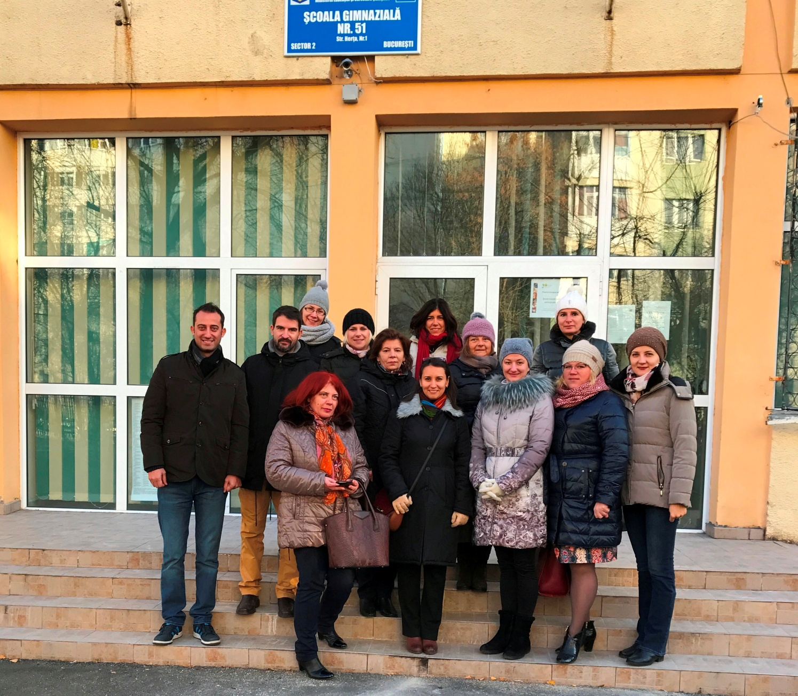
All Project Participants

Slide 7
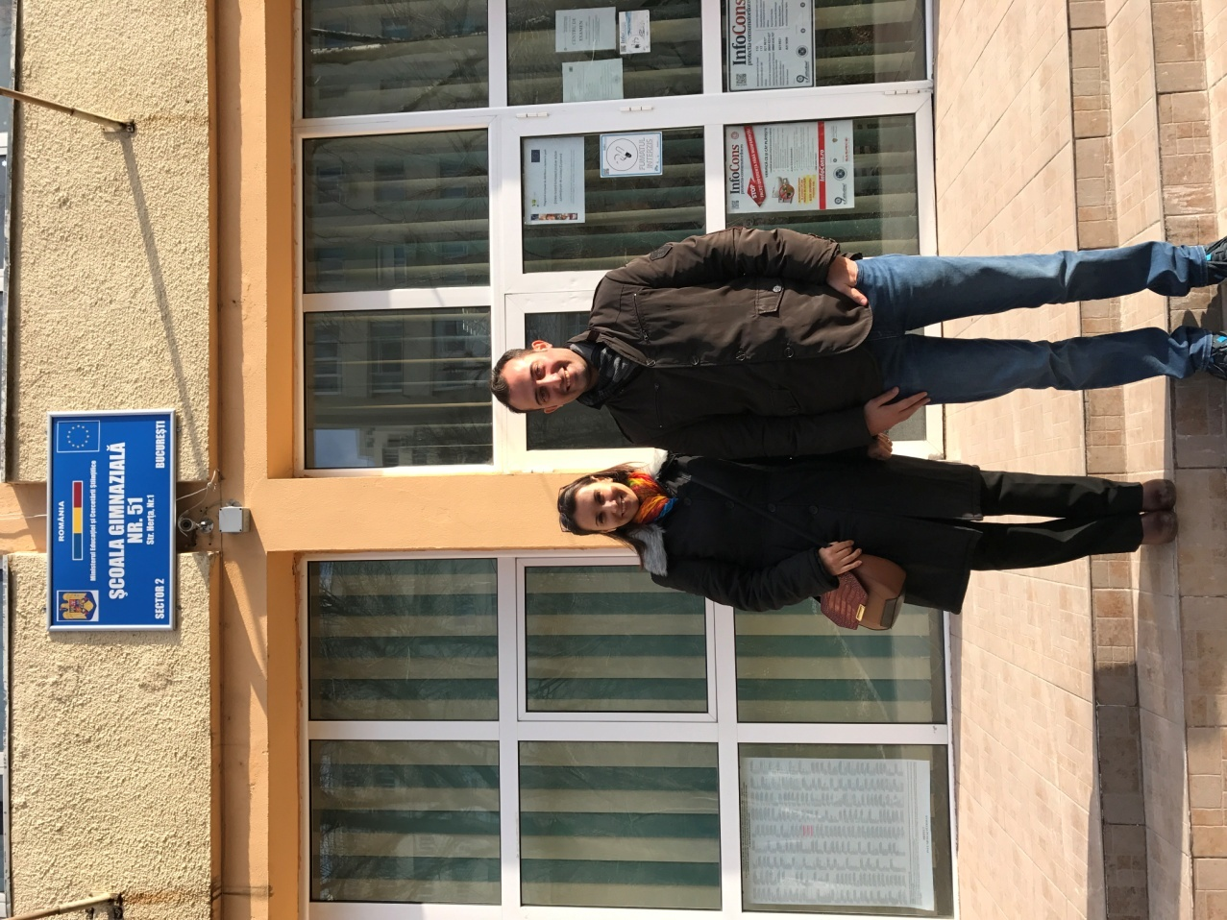
Our School Participants

Slide 8
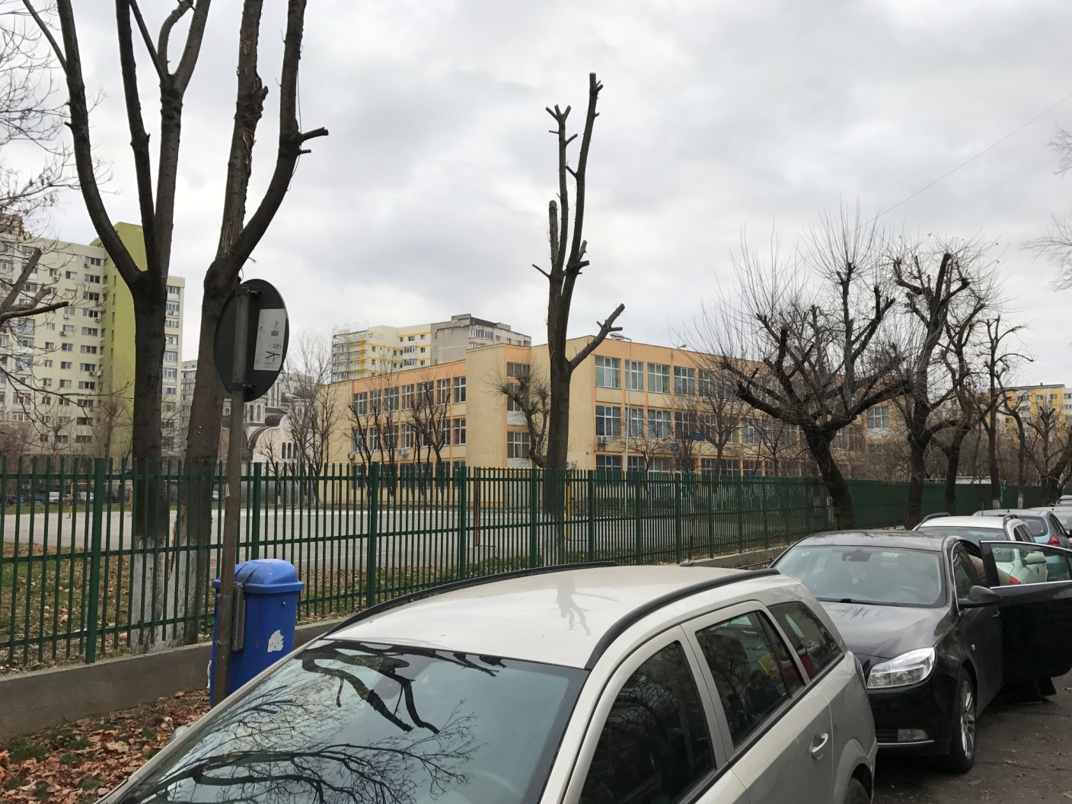
On the school way

Slide 9
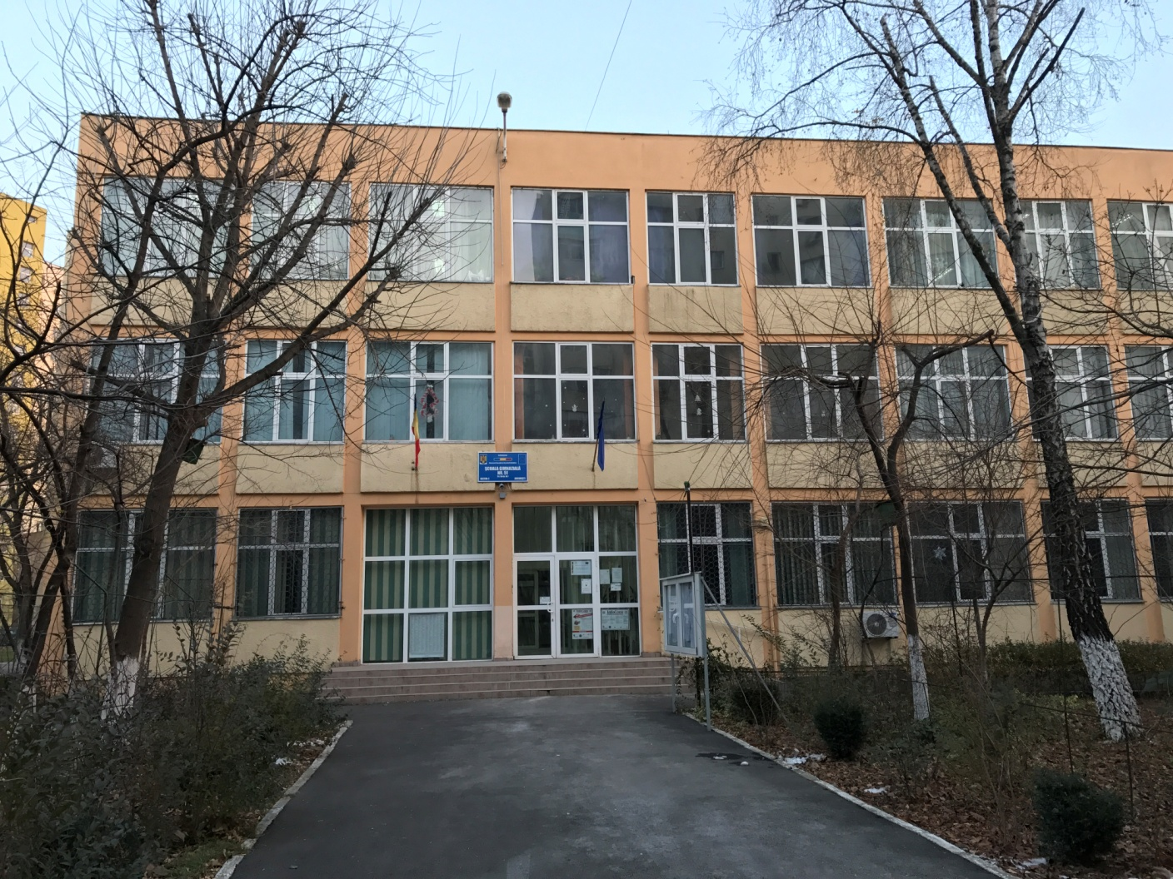
SCOALA GIMNAZIALA NR 51

Slide 10
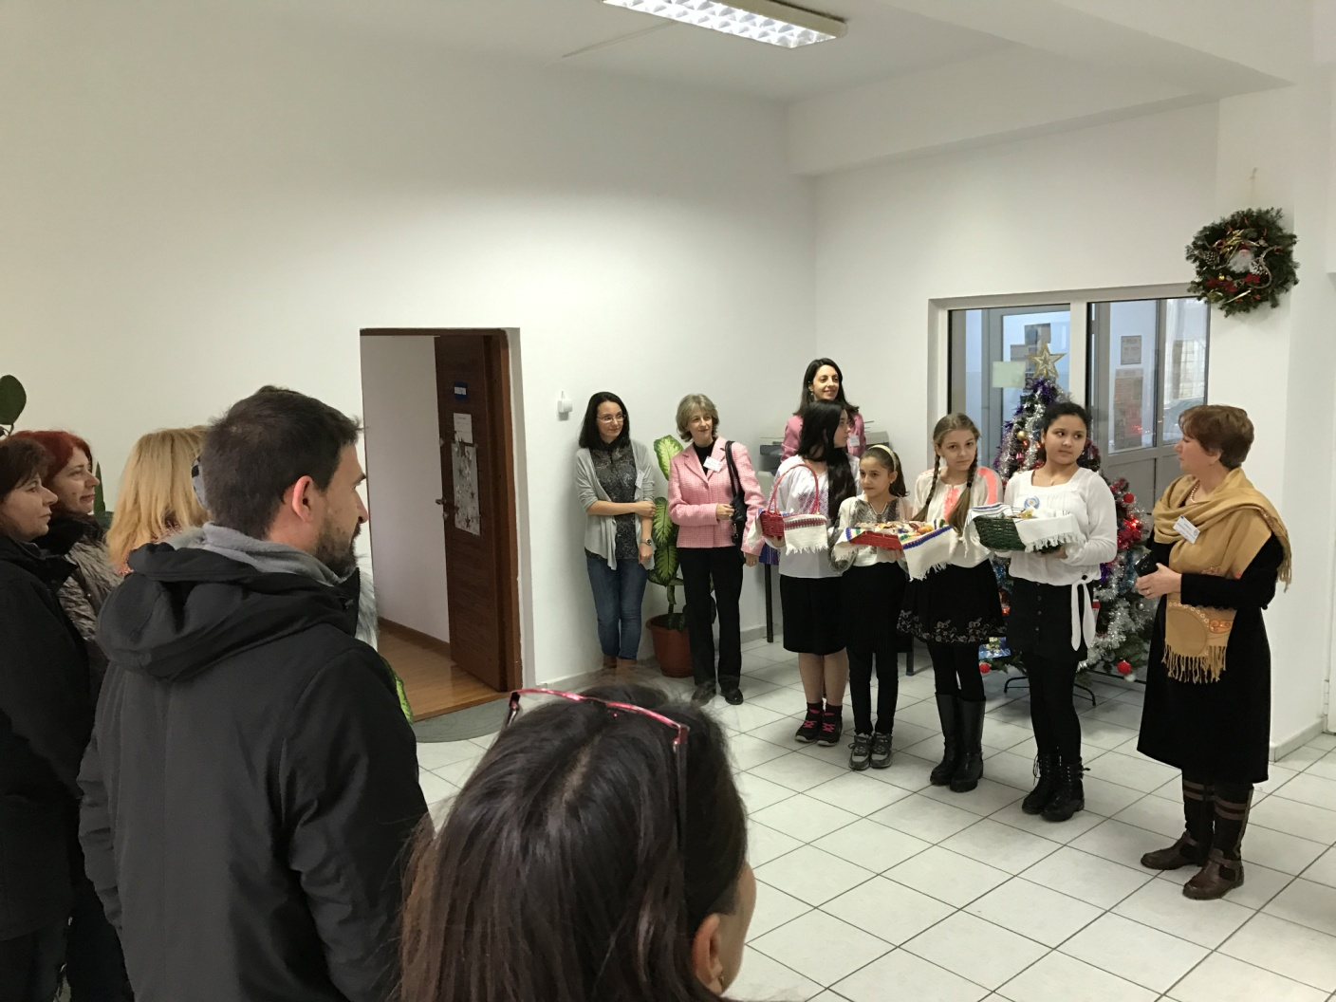
Welcome meeting

Slide 11
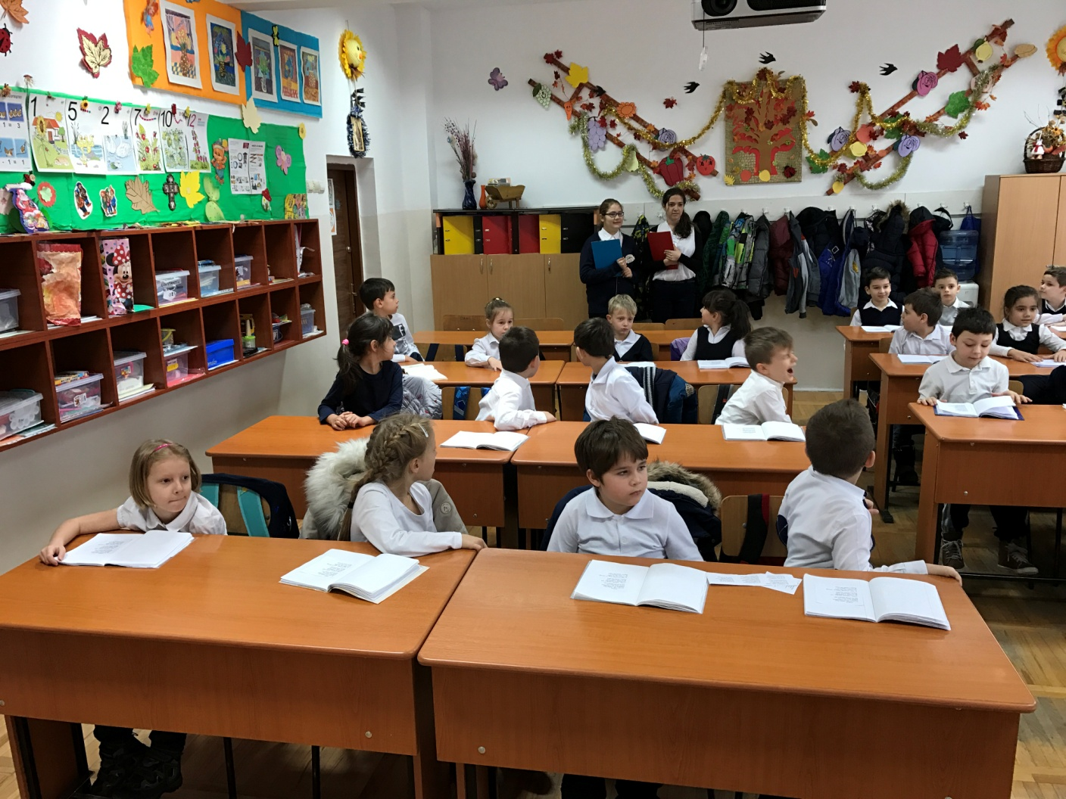
Class Observation

Slide 12
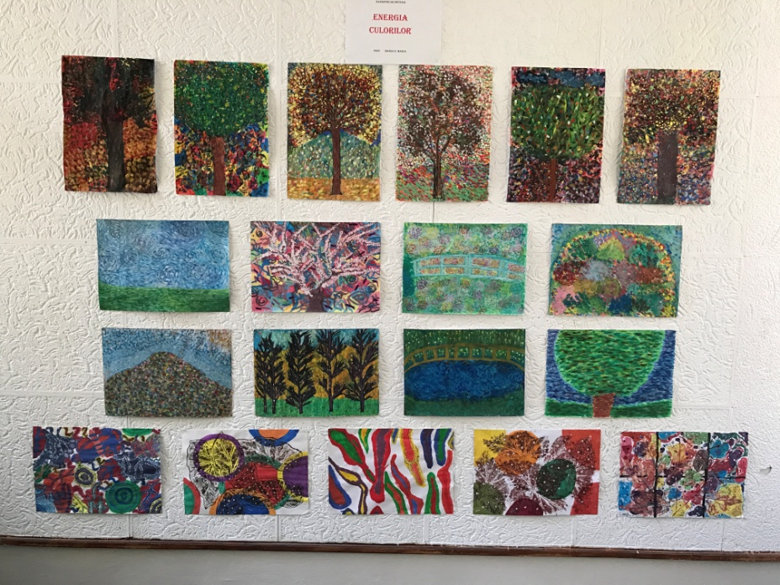
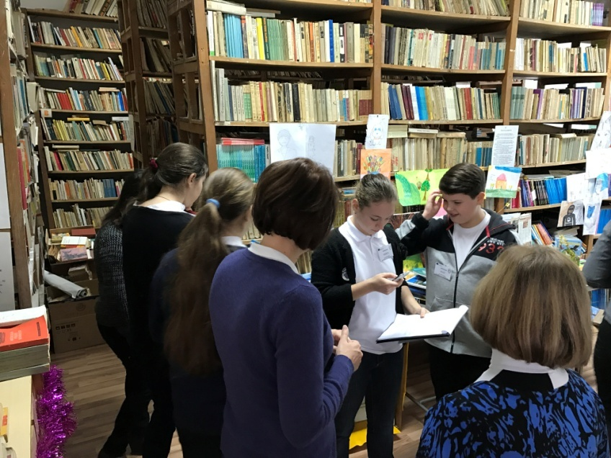
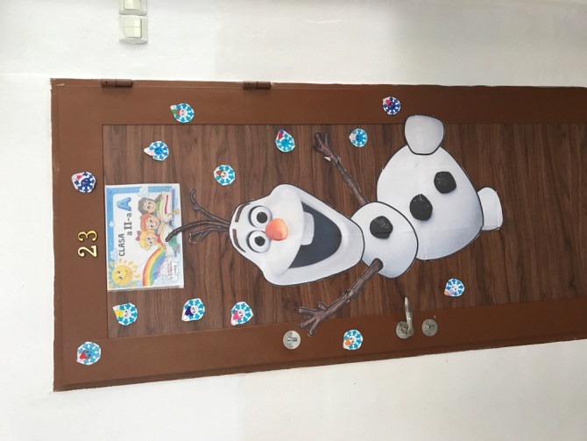
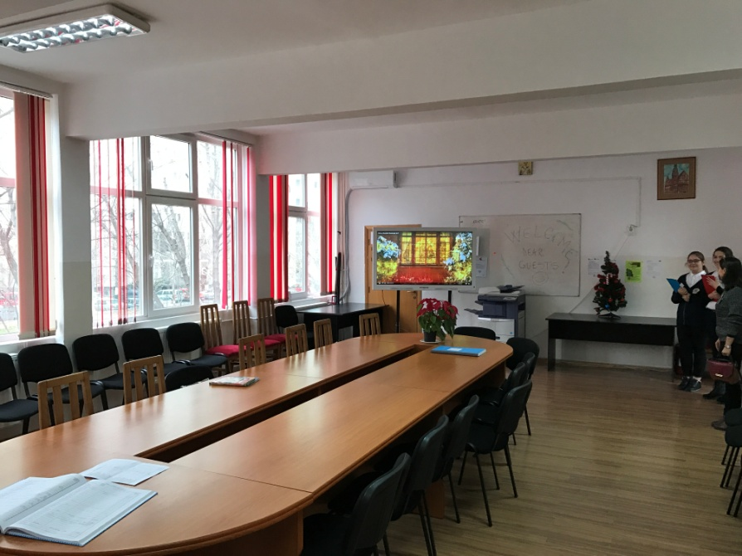
School Trip

Slide 13
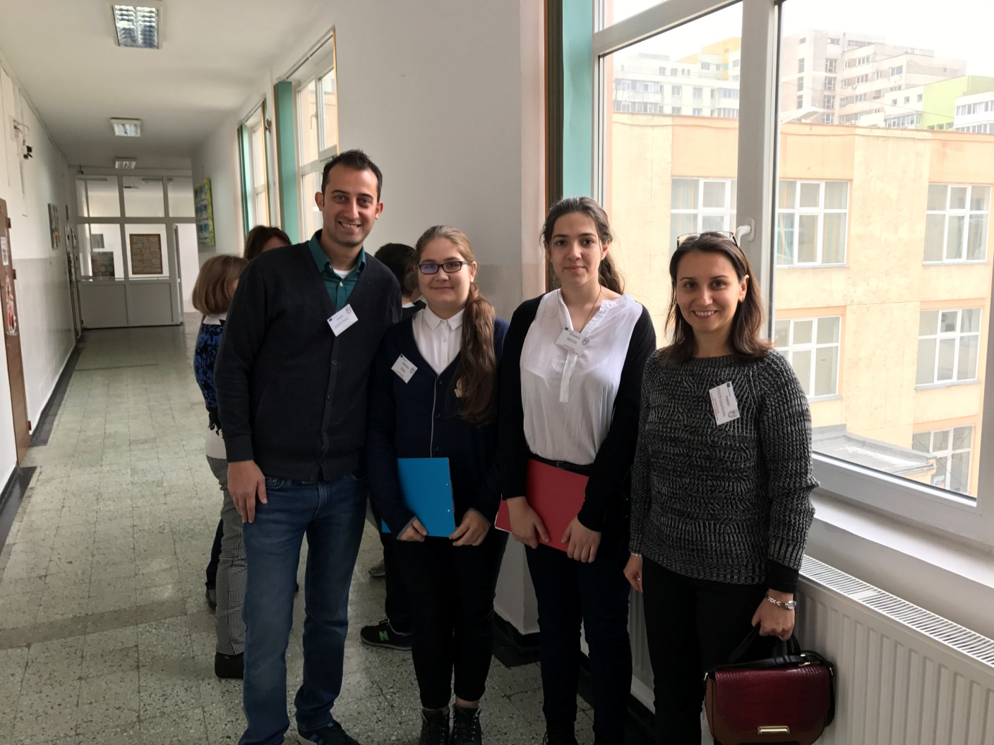
Pupil Guides

Slide 14
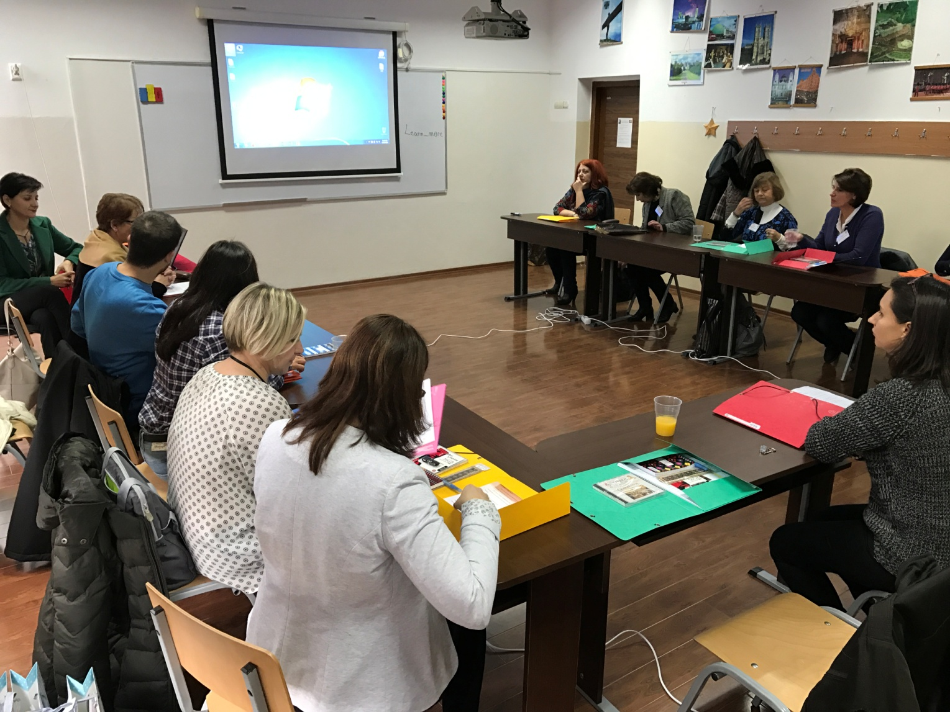
Cabinet of foreign languages/
Meeting Hall

Slide 15
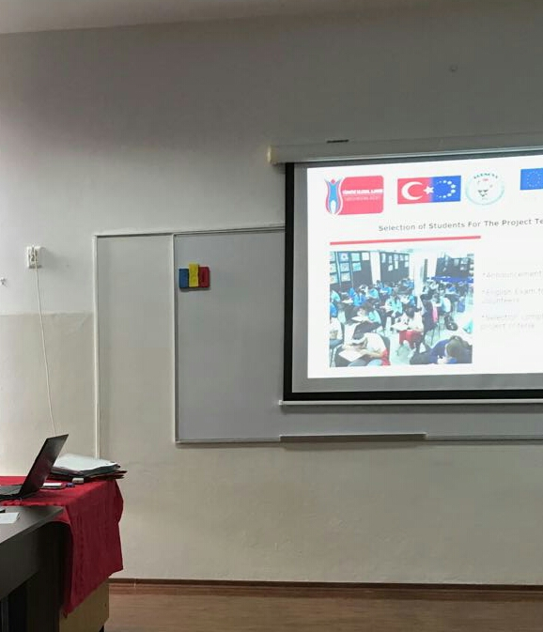

Slide 16
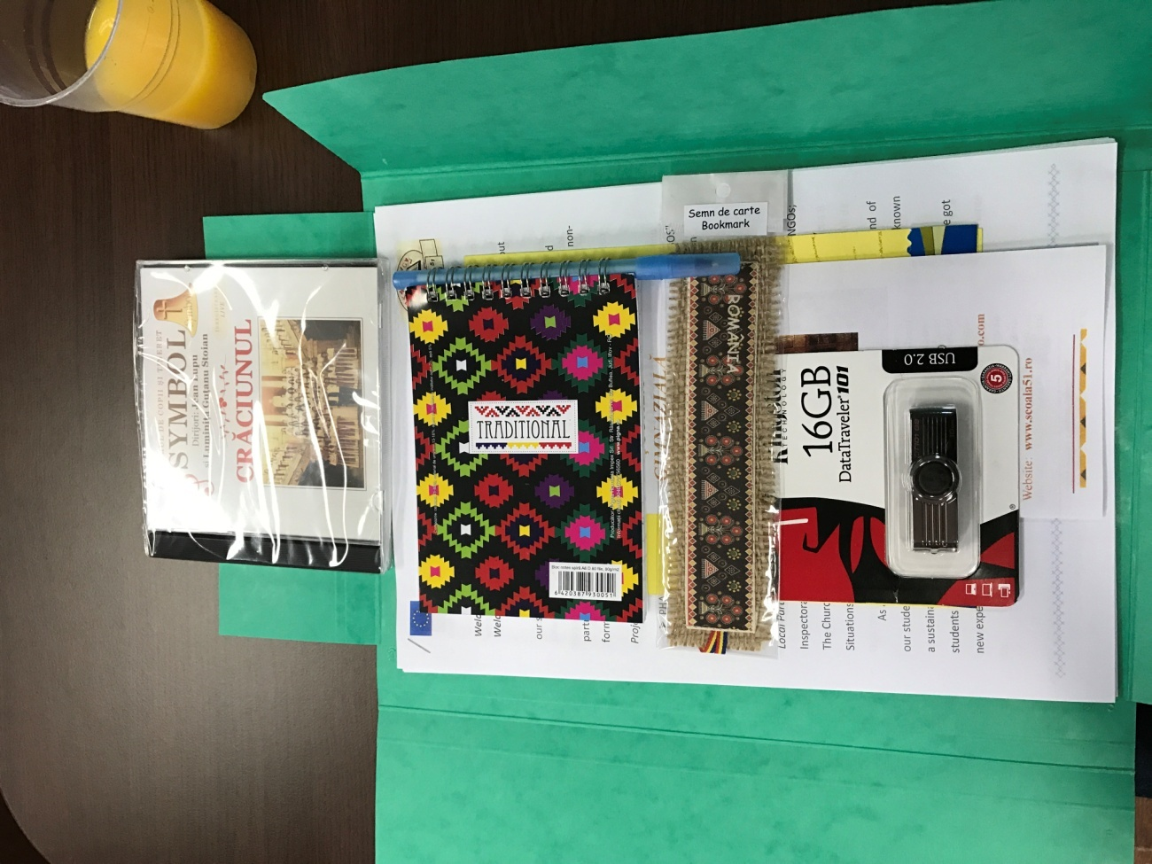
Participants’ packages

Slide 17
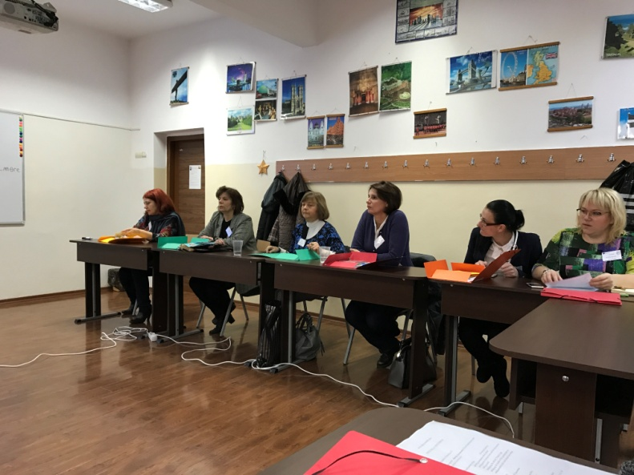
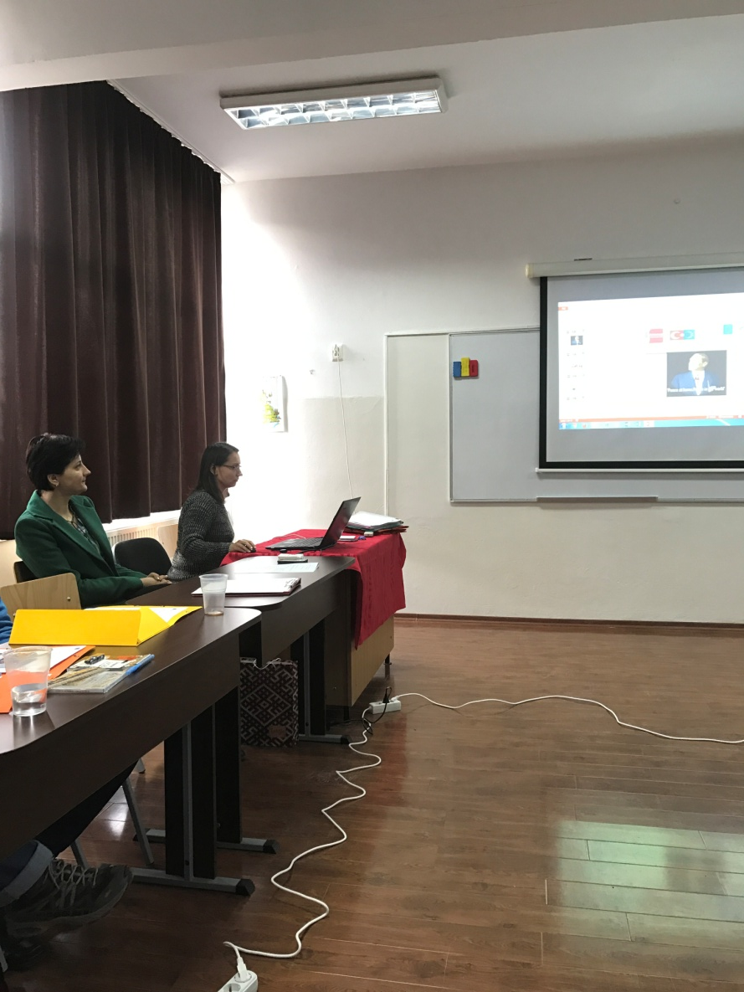
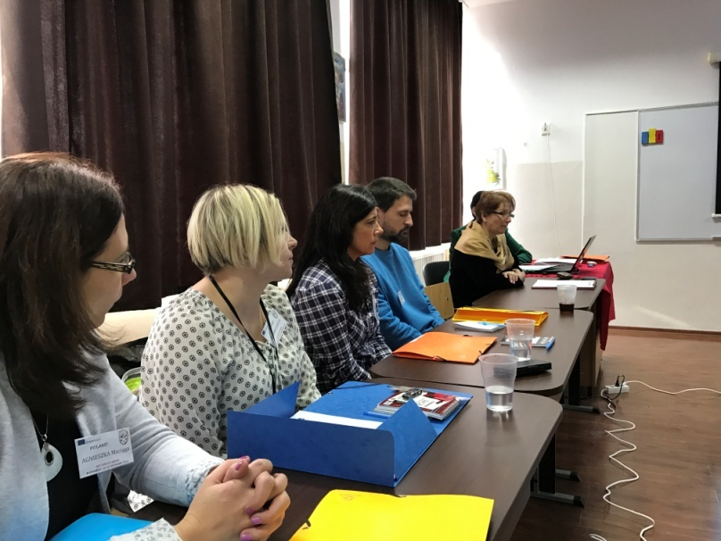
Presentation Time

Slide 18
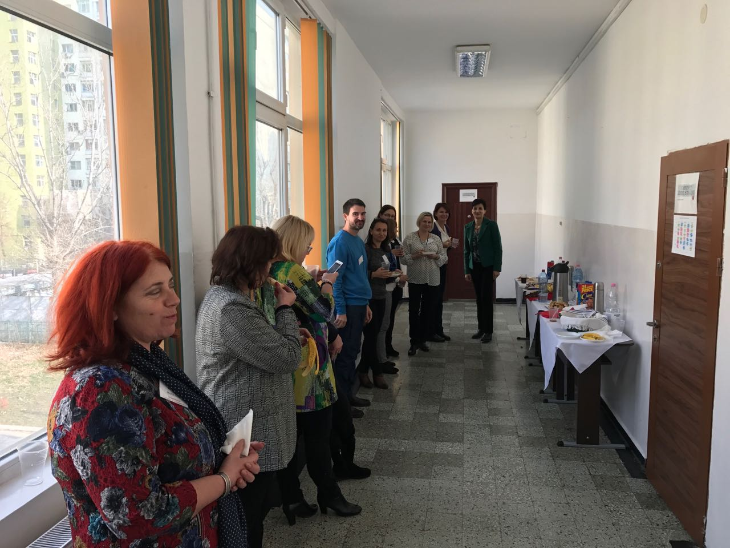
Coffee Break

Slide 19
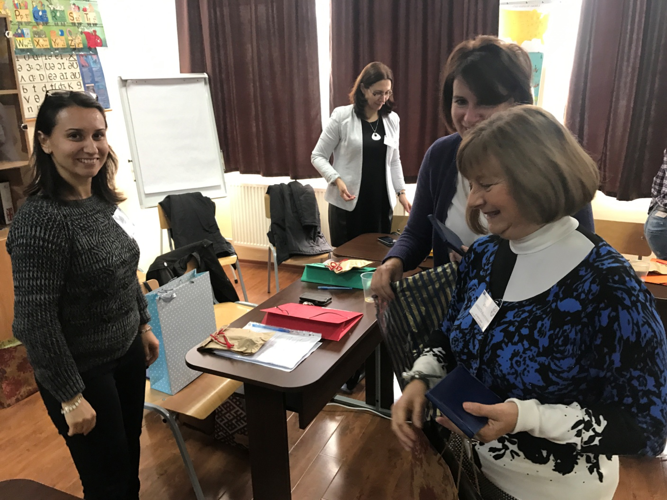
Echanging the presents

Slide 20
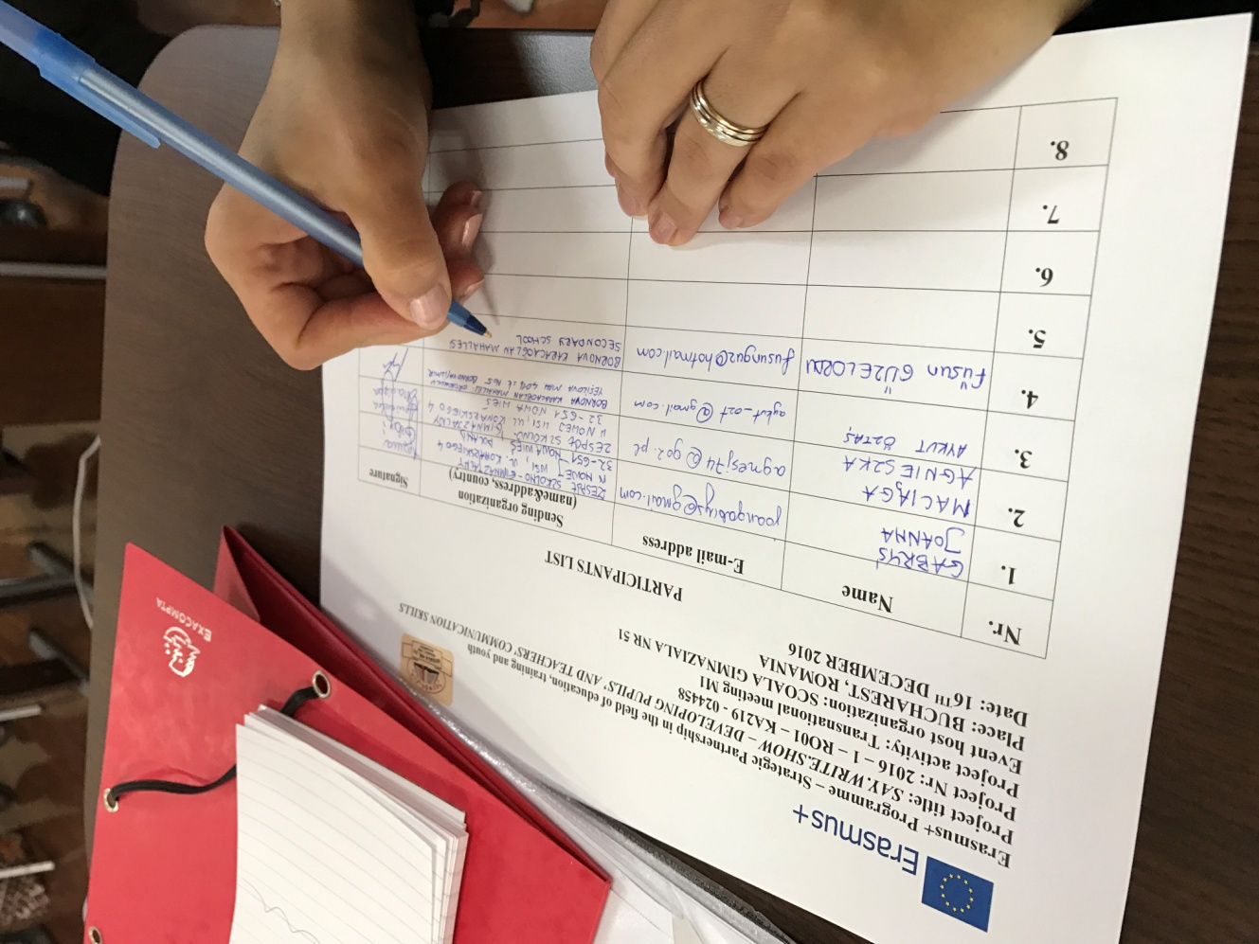
Signing the participant list

Slide 21
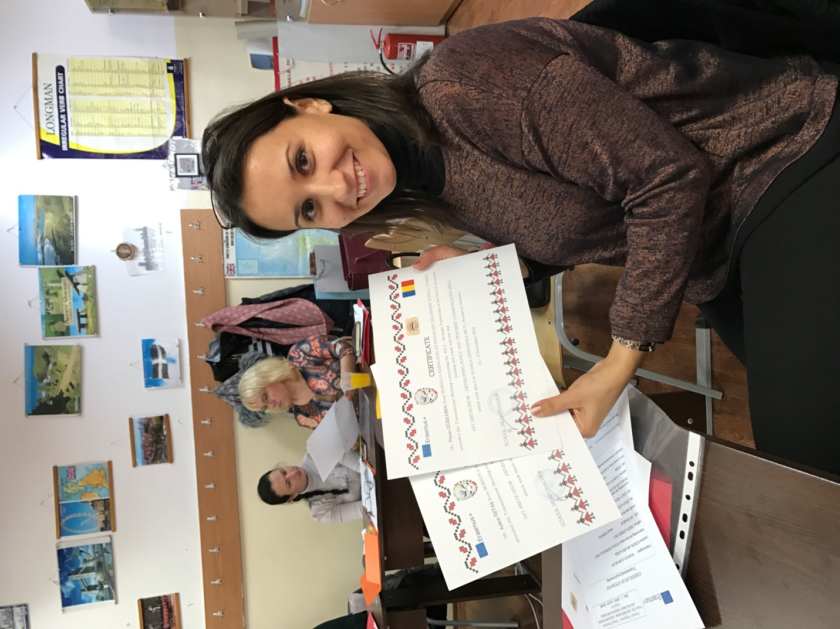
GETTING PARTICIPATION CERTIFICATES

Slide 22
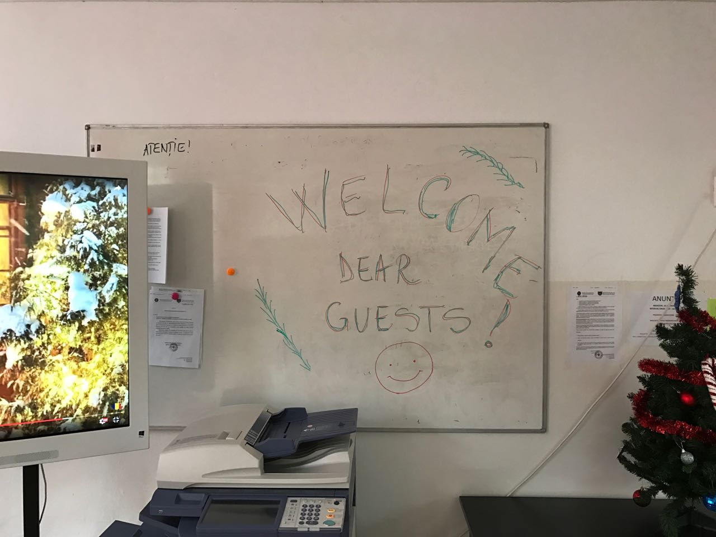
THANK YOU BUCHAREST!

