Slide 1
SAY.WRITE.SHOW – DEVELOPING STUDENTS’ AND TEACHERS’ COMMUNICATION SKILLS
TRANSNATIONAL MEETING
POLAND – NOWA WİES
15-18 FEBRUARY 2017
BORNOVA KARACAOĞLAN MAHALLESİ ORTAOKULU

Slide 2
THE OFFICIAL WELCOMING

Slide 3
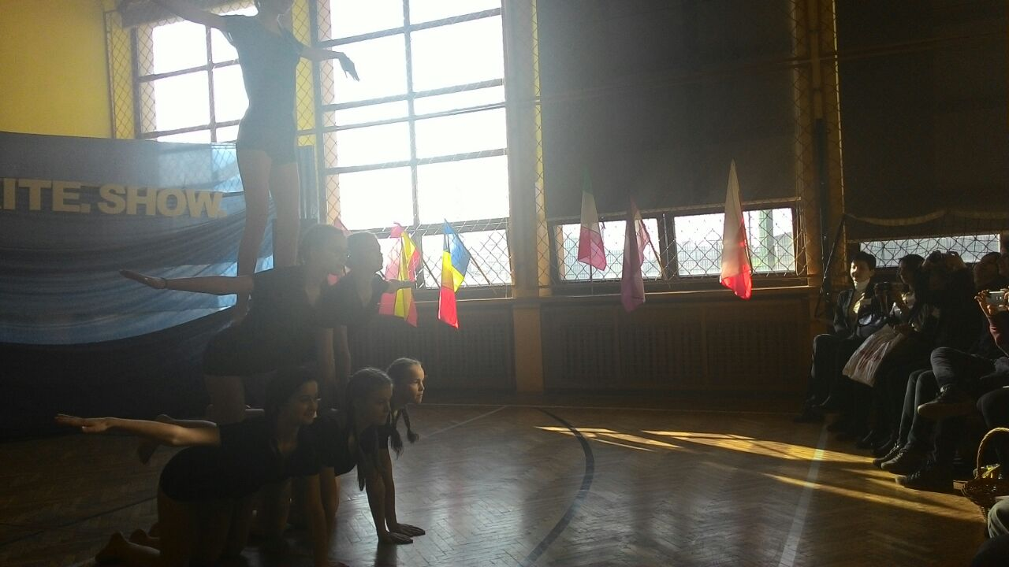
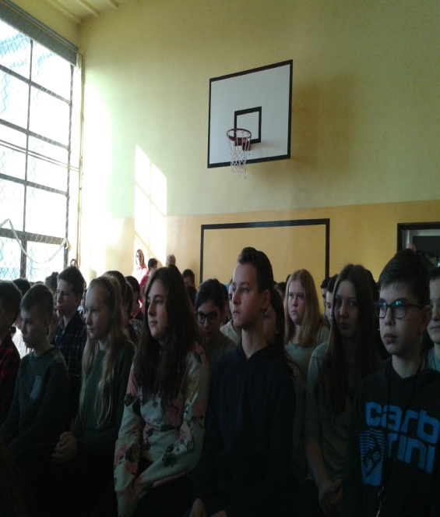
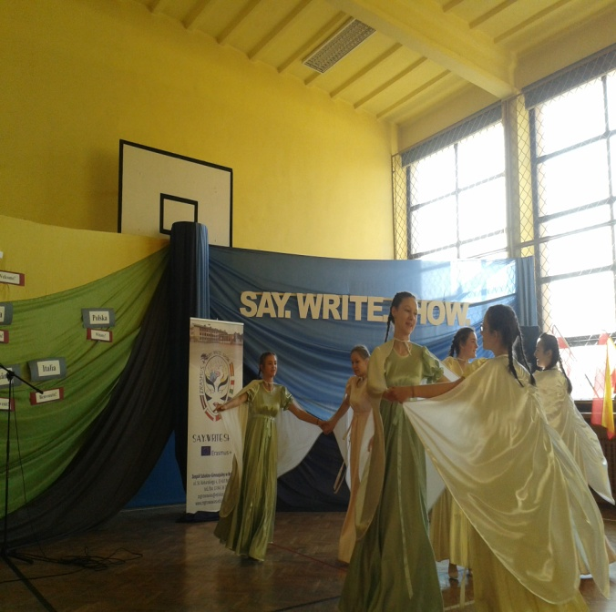
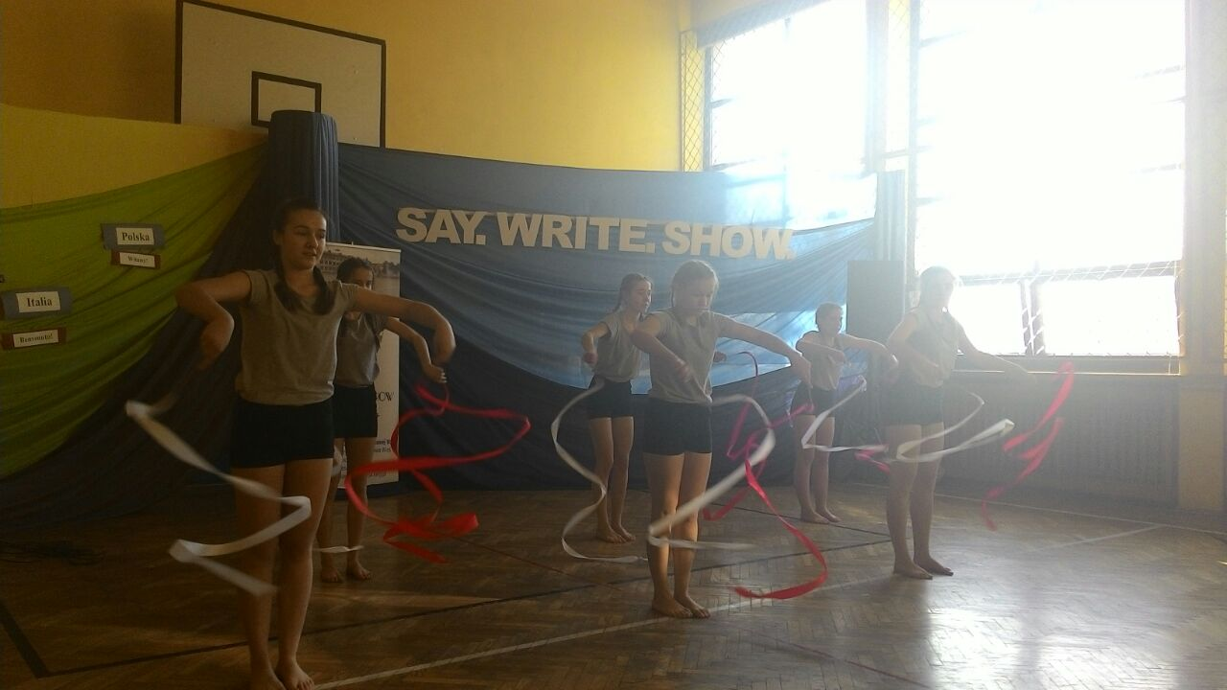
PERFORMANCE BY PUPILS

Slide 4
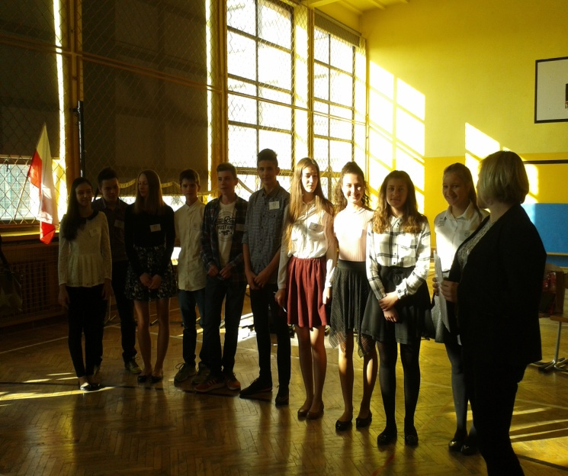
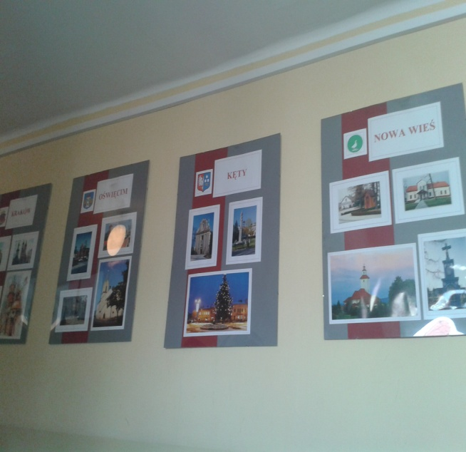
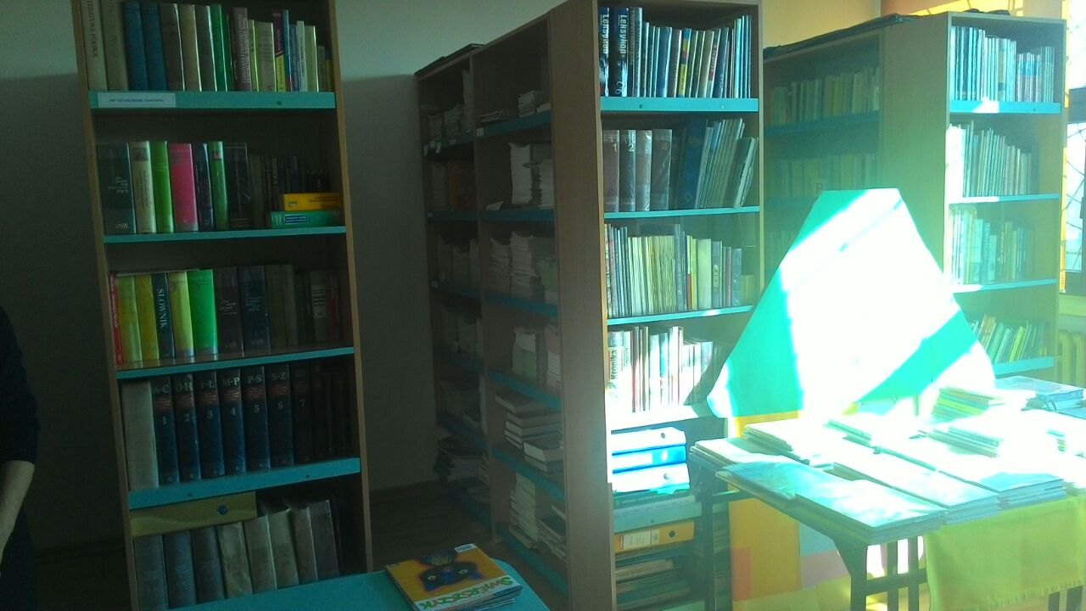
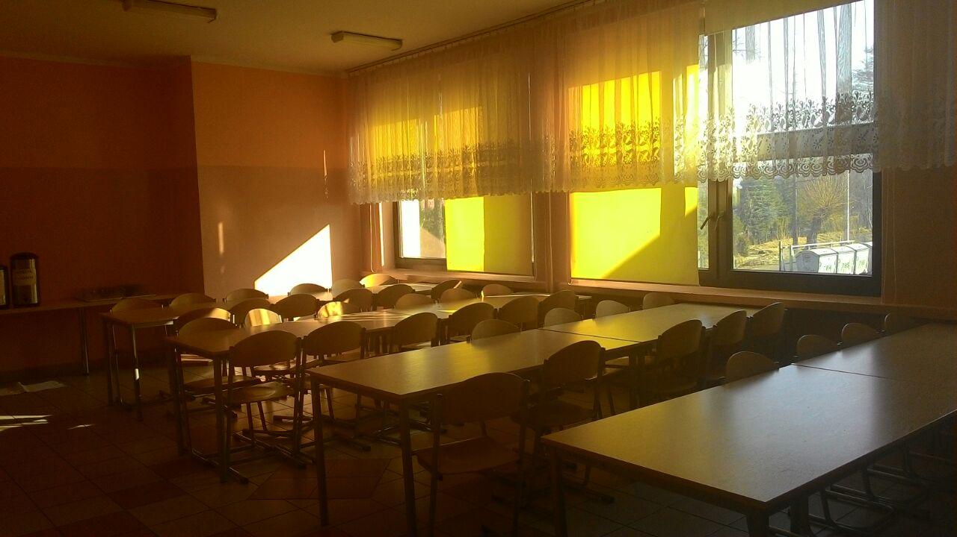
A GUIDED SCHOOL TOUR

Slide 5
Presentations of each partner school - activity A6 “I AM ... AND THIS IS MY PARTNER COUNTRY”

Slide 6
Organizing the activities C1 – Blended mobility of school learners and C2 – Short –term joint staff training events in Spain

Slide 7
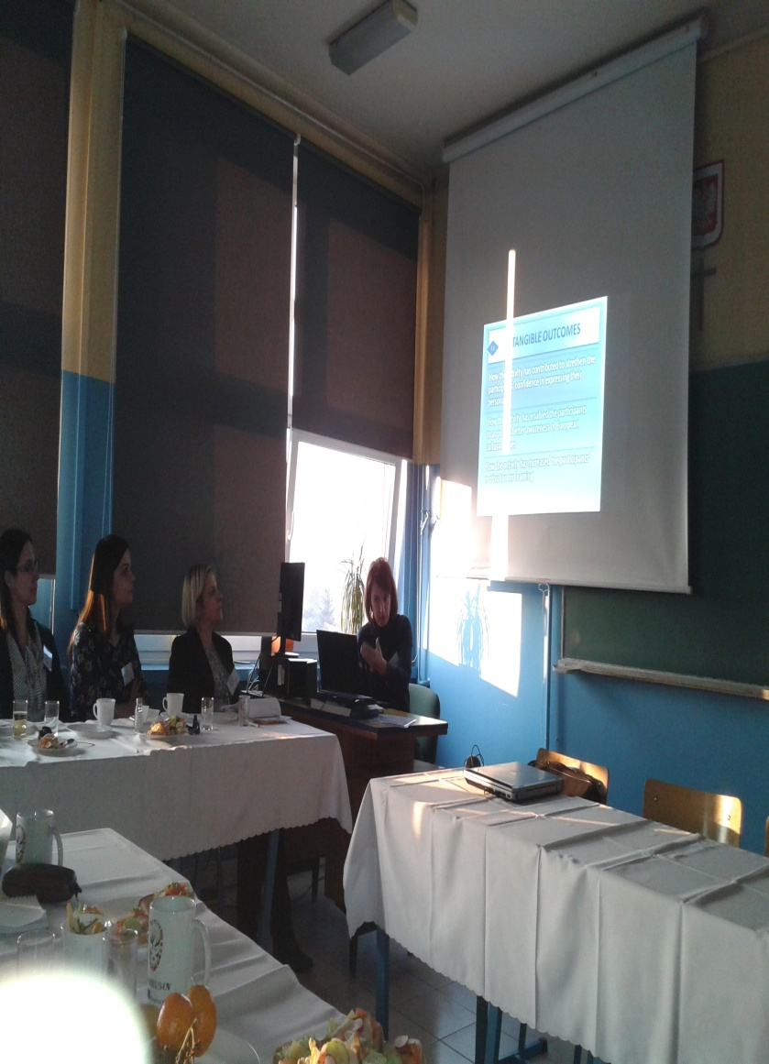
PRESENTATONS FOR THE RESOURCE BOOK

Slide 8
CONCLUSIONS
There has to be a continuation of A6 activity – each partner school organizes a display with presentations made by students from partner countries
Send in the missing school presentations and questionnaires to upload to the project website,
Facebook – coordinators should be made administrators of the page.
Before the mobility takes place, the Spanish teachers will prepare a draft of skills that the participants are likely to develop during the mobility (for Europass Mobility Certificate completion by coordinators).
Raquel adds timing to the planned activities

Slide 9
CONCLUSIONS
E-POSTCARD: Make students come up with simple sentences,
choose 6 best ones
Use IT tools to make a poster/1 slide with the chosen 6 sentences
decorate your slide and upload it to Facebook, project’s website ect.
Each country should have the idea of what to present in the play.
In Spain, students in national groups will work on the dialogues about the boy’s visit to their country (take creative students with good writing skills).
Students will make the drafts of the play in Spain and the drafts will be given to the teachers to check. Students will
Before the visit to Spain, talk with the students what they will have to do and brainstorm the ideas about the play with them.
The Spanish and Polish partners collect the material for the resource book.

Slide 10
ALL PROJECT PARTICIPANTS

Slide 11
OUR SCHOOL PARTICIPANTS

Slide 12
ON THE SCHOOL WAY

Slide 13
ZESPÓŁ SZKOLNO-GIMNAZJALNY W NOWEJ WSI

Slide 14
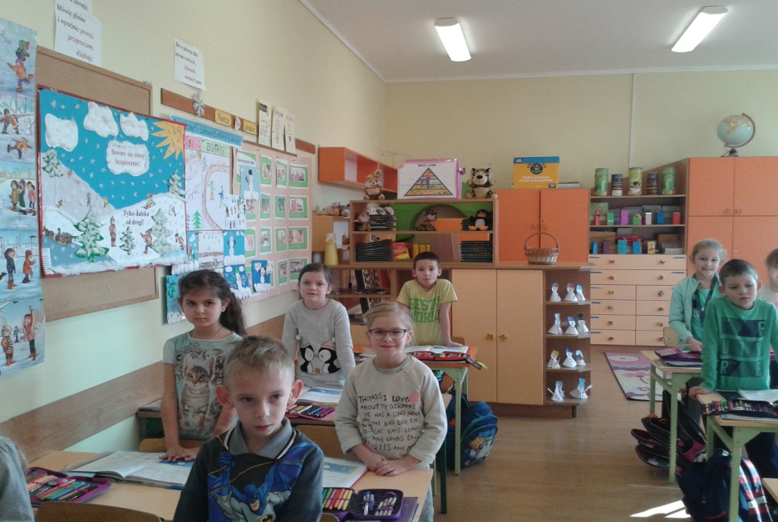
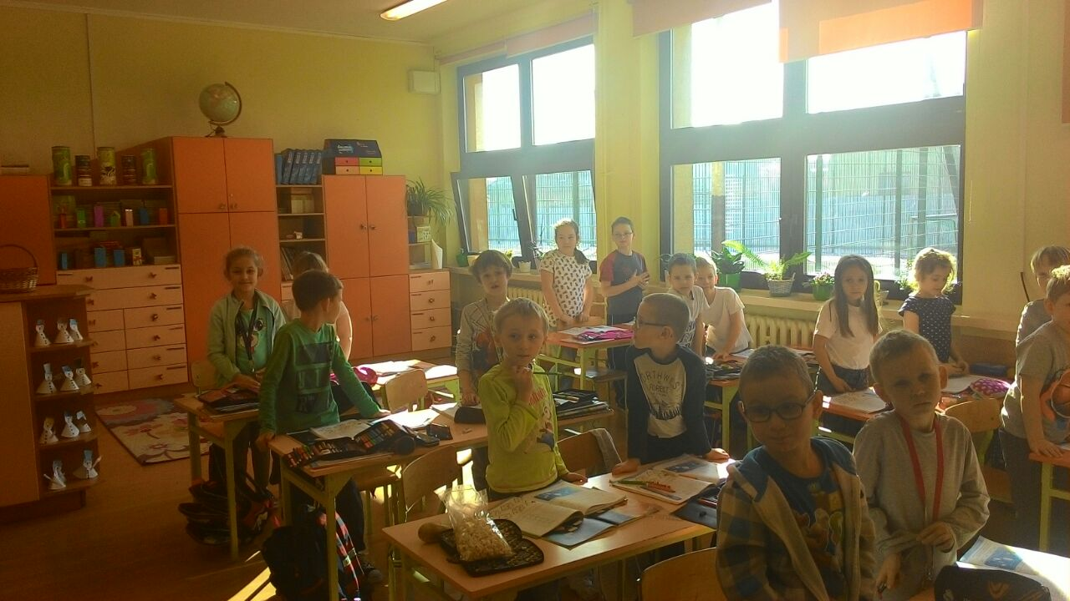
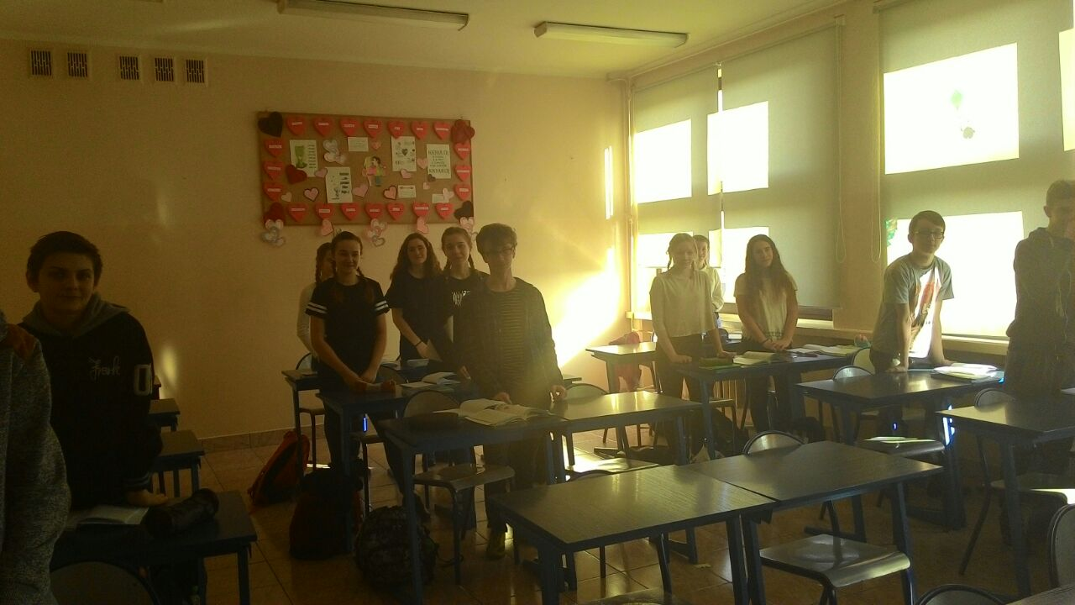
CLASS OBSERVATION

Slide 15
PARTICIPANTS’ PACKAGES

Slide 16
SIGNING THE PARTICIPANTS LIST

Slide 17
PARTICIPANT CERTIFICATES

Slide 18
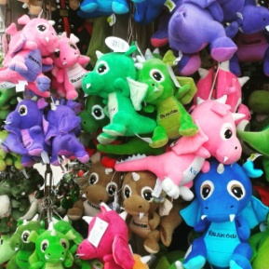
THANK YOU NOWA WİES!

